Slide 1
Diyala university
College of engineering
Department of computer engineering
Second stage
8086 Microprocessor
Assistant lecturer: Abdullah Thaier Abdalsatir

Slide 2
8086
Microprocessor
Instruction Set
2. Arithmetic Instructions
Mnemonics: ADD, ADC, SUB, SBB, INC, DEC, MUL, DIV, CMP…
SBB reg2/ mem, reg1/mem
SBB reg2, reg1
(reg2)  (reg1) - (reg2) -
CF
SBB reg2, mem
(reg2)  (reg2) - (mem)- CF
SBB mem, reg1
(mem)  (mem) - (reg1) CF
–
SBB reg/mem, data
SBB reg, data
(reg)  (reg) – data -
CF
SBB mem, data
(mem)  (mem) - data -
CF
SBB A, data
SBB AL, data8
(AL)  (AL) - data8 - CF
SBB AX, data16
(AX)  (AX) - data16 - CF
61

Slide 3
8086
Microprocessor
Instruction Set
2. Arithmetic Instructions
Mnemonics: ADD, ADC, SUB, SBB, INC, DEC, MUL, DIV, CMP…
INC reg/ mem
INC reg8
(reg8)  (reg8) + 1
INC reg16
(reg16)  (reg16) + 1
INC mem
(mem)  (mem) + 1
DEC reg/ mem
DEC reg8
(reg8)  (reg8) - 1
DEC reg16
(reg16)  (reg16) - 1
DEC mem
(mem)  (mem) - 1
62

Slide 4
8086
Microprocessor
Instruction Set
2. Arithmetic Instructions
Mnemonics: ADD, ADC, SUB, SBB, INC, DEC, MUL, DIV, CMP…
MUL reg/ mem
MUL reg
For byte : (AX)  (AL) x (reg8)
For word : (DX)(AX)  (AX) x (reg16)
MUL mem
For byte : (AX)  (AL) x (mem8)
For word : (DX)(AX)  (AX) x (mem16)
IMUL reg/ mem
IMUL reg
For byte : (AX)  (AL) x (reg8)
For word : (DX)(AX)  (AX) x (reg16)
IMUL mem
For byte : (AX)  (AX) x (mem8)
For word : (DX)(AX)  (AX) x (mem16)
63

Slide 5
8086
Microprocessor
Instruction Set
2. Arithmetic Instructions
Mnemonics: ADD, ADC, SUB, SBB, INC, DEC, MUL, DIV, CMP…
DIV reg/ mem
DIV reg
For 16-bit :- 8-bit :
(AL)  (AX) :- (reg8)
Quotient
(AH)  (AX) MOD(reg8)
Remainder
For 32-bit :- 16-bit :
(AX)  (DX)(AX) :- (reg16)
Quotient
(DX)  (DX)(AX) MOD(reg16) Remainder
DIV mem
For 16-bit :- 8-bit :
(AL)  (AX) :- (mem8)
Quotient
(AH)  (AX) MOD(mem8) Remainder
For 32-bit :- 16-bit :
(AX)  (DX)(AX) :- (mem16) Quotient
(DX)  (DX)(AX) MOD(mem16)
Remainder
64

Slide 6
8086
Microprocessor
Instruction Set
2. Arithmetic Instructions
Mnemonics: ADD, ADC, SUB, SBB, INC, DEC, MUL, DIV, CMP…
IDIV reg/ mem
IDIV reg
For 16-bit :- 8-bit :
(AL)  (AX) :- (reg8)
Quotient
(AH)  (AX) MOD(reg8)
Remainder
For 32-bit :- 16-bit :
(AX)  (DX)(AX) :- (reg16)
Quotient
(DX)  (DX)(AX) MOD(reg16) Remainder
IDIV mem
For 16-bit :- 8-bit :
(AL)  (AX) :- (mem8)
Quotient
(AH)  (AX) MOD(mem8) Remainder
For 32-bit :- 16-bit :
(AX)  (DX)(AX) :- (mem16) Quotient
(DX)  (DX)(AX) MOD(mem16)
Remainder
65

Slide 7
8086
Microprocessor
Instruction Set
2. Arithmetic Instructions
Mnemonics: ADD, ADC, SUB, SBB, INC, DEC, MUL, DIV, CMP…
CMP reg2/mem, reg1/ mem
CMP reg2, reg1
Modify flags  (reg2) –
(reg1)
If (reg2) > (reg1) then CF=0, ZF=0, SF=0
If (reg2) < (reg1) then CF=1, ZF=0, SF=1
If (reg2) = (reg1) then CF=0, ZF=1, SF=0
CMP reg2, mem
Modify flags  (reg2) –
(mem)
If (reg2) > (mem) then CF=0, ZF=0, SF=0
If (reg2) < (mem) then CF=1, ZF=0, SF=1
If (reg2) = (mem) then CF=0, ZF=1, SF=0
CMP mem, reg1
Modify flags  (mem) –
(reg1)
If (mem) > (reg1) then CF=0, ZF=0, SF=0
If (mem) < (reg1) then CF=1, ZF=0, SF=1
If (mem) = (reg1) then CF=0, ZF=1, SF=0
66

Slide 8
8086
Microprocessor
Instruction Set
2. Arithmetic Instructions
Mnemonics: ADD, ADC, SUB, SBB, INC, DEC, MUL, DIV, CMP…
CMP reg/mem, data
CMP reg, data
Modify flags  (reg) –
(data)
If (reg) > data then CF=0, ZF=0, SF=0
If (reg) < data then CF=1, ZF=0, SF=1
If (reg) = data then CF=0, ZF=1, SF=0
CMP mem, data
Modify flags  (mem) –
(mem)
If (mem) > data then CF=0, ZF=0, SF=0
If (mem) < data then CF=1, ZF=0, SF=1
If (mem) = data then CF=0, ZF=1, SF=0
67

Slide 9
8086
Microprocessor
Instruction Set
2. Arithmetic Instructions
Mnemonics: ADD, ADC, SUB, SBB, INC, DEC, MUL, DIV, CMP…
CMP A, data
CMP AL, data8
Modify flags  (AL) –
data8
If (AL) > data8 then CF=0, ZF=0, SF=0
If (AL) < data8 then CF=1, ZF=0, SF=1
If (AL) = data8 then CF=0, ZF=1, SF=0
CMP AX, data16
Modify flags  (AX) –
data16
If (AX) > data16
then CF=0, ZF=0, SF=0
If (mem) < data16 then CF=1, ZF=0, SF=1
If (mem) = data16 then CF=0, ZF=1, SF=0
68

Slide 10
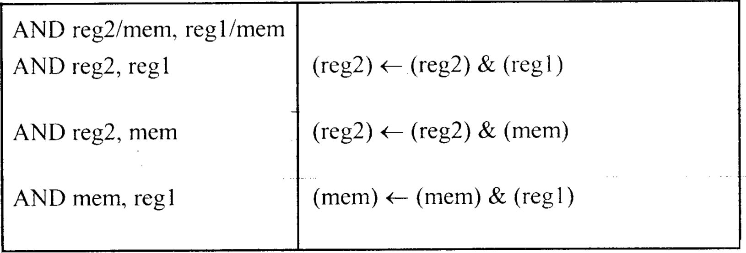
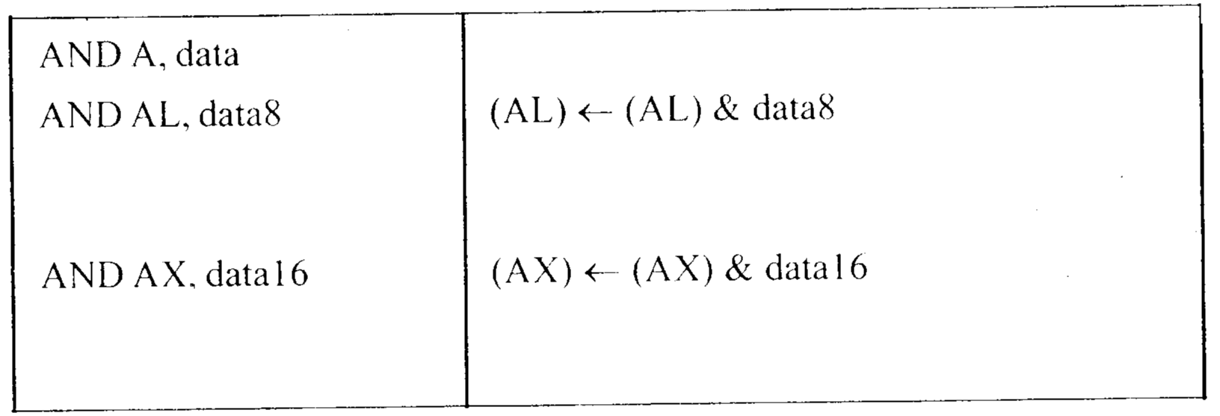
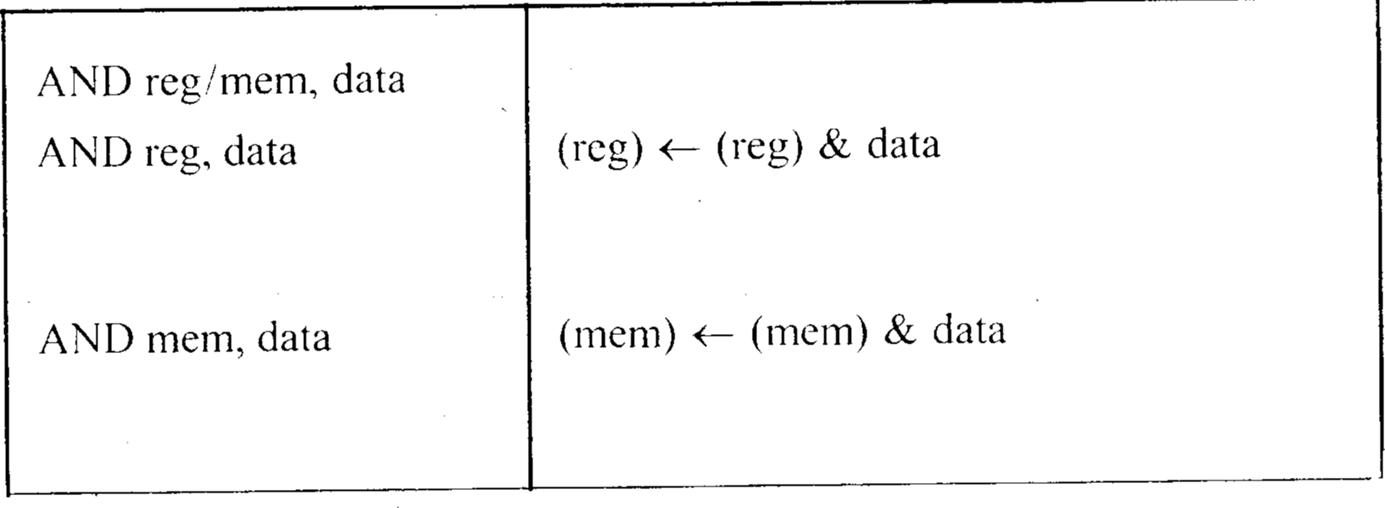
8086
Microprocessor
Instruction Set
3. Logical Instructions
Mnemonics: AND, OR, XOR, TEST, SHR, SHL, RCR, RCL …
69

Slide 11
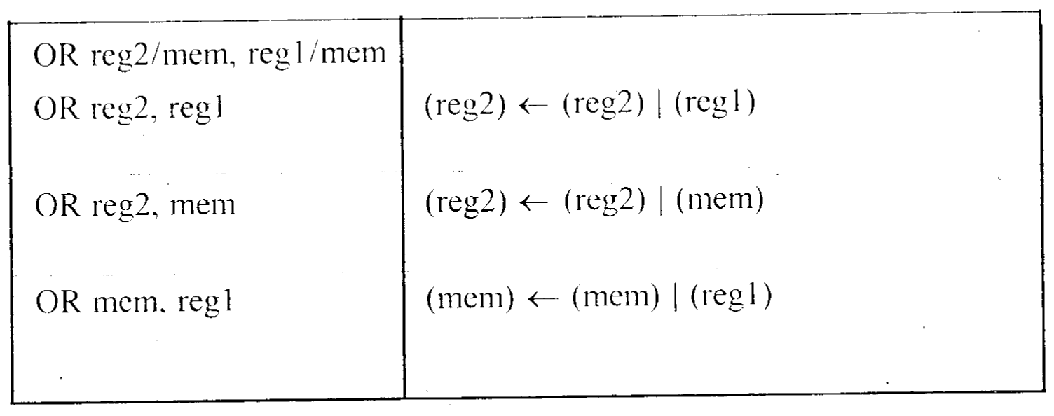
8086
Microprocessor
Instruction Set
3. Logical Instructions
Mnemonics: AND, OR, XOR, TEST, SHR, SHL, RCR, RCL …
70

